Slide 1
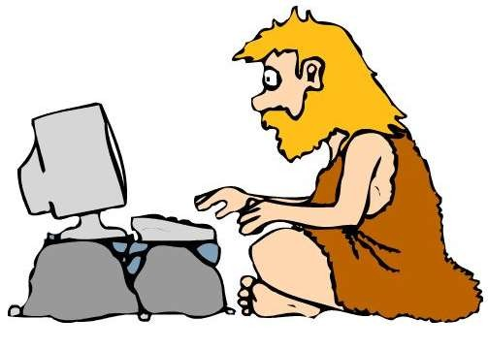
How, When and Where

Slide 2
Synopsis
Introduction
Meaning
Caste system
Character name James Rennel
Britannica/ East India Company
History is referred to as a span of time.
Criteria to select a set of dates
Warren Hastings
Criteria to periodise
Prior to British Rule
Classification of Indian history
Time notation
Change of modern period to colonial
Sources of writing history
What official record do not tell

Slide 3
Introduction to History
History is the study of past events and it is much more than memorising dates.
In this lesson we will learn: “how did it happen”, “when did it happen” and “where did it happen”.

Slide 4
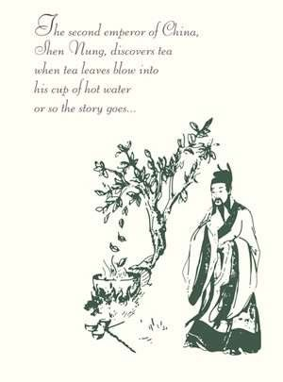
Meaning of History
History is about changes that occur over time.
I.e., finding how things were in the past and how things have changed.

Slide 5
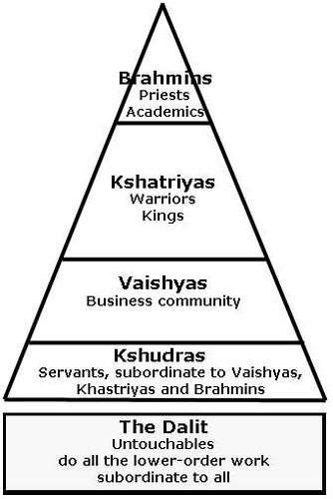
Caste System in Hinduism
There are 5 types of caste in Hinduism

Slide 6
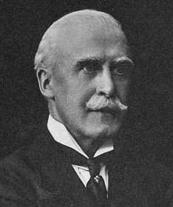
James Rennel
He was born on Dec 3, 1742 in England and died on March 29, 1830.
He was the leading British Geographer of his time. He constructed the first nearly accurate map of India.
He joined East India Company and became Surveyor General of Bengal (1764-77)

Slide 7
Britannica/East India Company
English company formed for the exploitation of trade with East and Southeast Asia and India. Incorporated by Royal Charter on December 31, 1600.
Started as a monopolistic trading body, the company became involved in politics and acted as an agent of British imperialism in India from the early-18th century to the mid-19th century.
The activities of the company in China in the 19th century also served as a catalyst for the expansion of British influence there.

Slide 8
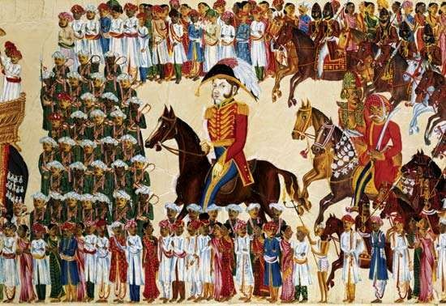
Official of East India Company riding in an Indian Procession

Slide 9
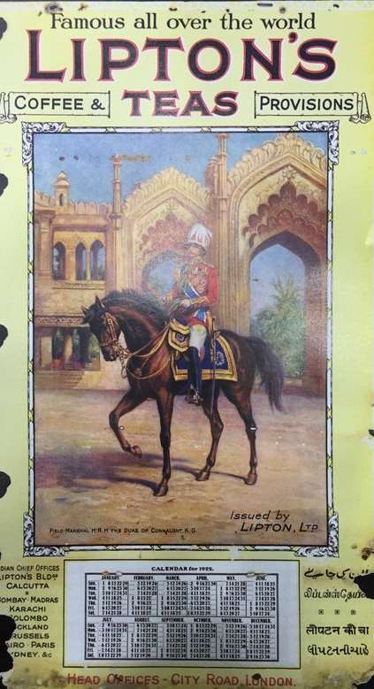
History is Referred to Span of Time
We cannot determine a specific date when British rule was started as it happened over a span of time.
Similarly, we developed a taste of drinking tea over a period of time.
See the advertisement on the right.

Slide 10
Past versus present state of history
Earlier history was associated with string of dates. This was because history used to keep a track of battles and big events.
At present, history is a wider concept which includes ‘how’ and ‘what’ concepts.
For example, how people earned their livelihood, what did they produce, and eat? Etc.

Slide 11
Criteria to select a set of dates
Dates become important when we assume that a particular set of events are important.
Most of the history in India was written by British historians. These historians started writing with the rule of first Governor-General, Warren Hastings and ended with the last Viceroy, Lord Mountbatten.

Slide 12
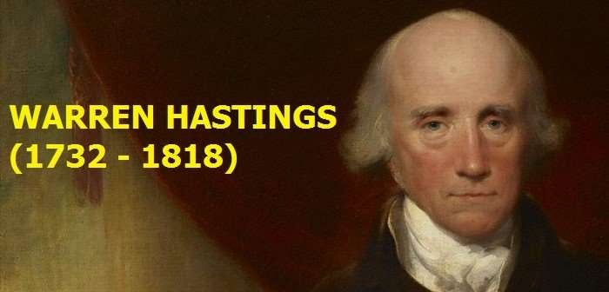
Warren Hastings
He became the first Governor-General of India in 1773.
Warren Hastings was a competent, honourable, and farsighted administrator, whose policies, while some controversial, decisively shaped and stabilized future Anglo-Indian relations.
The controversy surrounding his administration made him the subject of impeachment and trial in Great Britain.

Slide 13
Criteria to periodise
In 1817, a Scottish Economist and Political
Philosopher, named James Mill, published a book “History of
British India”.
In this book, the Indian history is divided into 3 periods:
Hindu
Muslim
British

Slide 14
Prior to British Rule
Before Britishers took over India, there were Hindu and Muslims rulers who used to exploit India. Furthermore, India strongly believed in: caste systems, multiple religions, superstitions, etc.
James Mill felt that only British rule could civilise India and teach them manners, arts and laws.

Slide 15
Indian History Classification
Ancient History – 4000 B.C. – A.D.500
Medieval History – A.D. 500 – A.D. 1500
Modern History – A.D. 1500 – Present

Slide 16
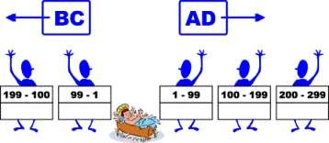
Time notation
The terms Anno Domini (AD) and before Christ (BC) are used to
label or number years in the Julian and Gregorian Calendars.
The term Anno Domini (A.D.) is Medieval Latin and means “in the year of the Lord”.
The term Before Christ (B.C.) an epoch used in dating years prior to the estimated birth of Jesus.

Slide 17
Modern period changed to Colonial
Modern period is related to growth of all the forces of
modernism. But under the British rule, people were not getting modernised. Therefore the name changed to Colonial period.
When the subjugation of one country by another leads to political, economic, social and cultural changes this is the process of Colonisation.

Slide 18
Sources of writing history
Sources that historians use in writing about last 250 years on Indian history includes:
1) Official records of the British Administration - For British, the act of writing was crucial. So every plan, policy agreement was in writing. This led to administrative culture of memos, noting and reports.
British also kept all the documents preserved in the record room which was attached to all administrative institutions. Moreover these documents were written by calligraphists, who specialised in the art of beautiful writing.

Slide 19
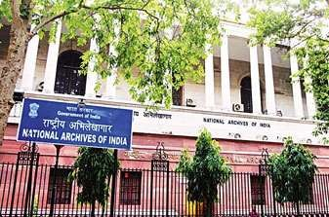
Sources of writing history
National archives of India, Delhi (1920s)
It is a record room where all the documents and letters from government and various administrators have been arranged as per dates from 18th century and are preserved in good conditions.

Slide 20
Sources of writing history
2) Conducting surveys - Conducting surveys was common under colonial administration. The British believed that a country had to be properly known before it could be effectively administered.
By the early 19th century, detailed surveys were being carried out to map the entire country.
For Example: forest survey, zoological survey, etc.

Slide 21
What official records do not tell
Records do not tell what other people in the country felt.
Only dairies of people, travellers, autobiographies of important personalities can tell about literate people.
No record of the history is available for the Tribals, peasants, workers or the poor.

Slide 22
Any Question? Thank You!
Let us see this vedeo clip.
https://www.youtube.com/watch?v=FHCz2WdfWKY

